Slide 1
R for statistics day 3 Graphs with ggplot!
George Savva (QIB)
July 2021

Slide 2
Day 3!
Day 2 revision
Linear models
Graphing
ggplot2
End!
Exercises toward the end
Please ask questions if you want to throughout
Files on the website
https://georgemsavva.github.io/R_for_Statistics/day3.html

Slide 3
Day 2 revision
Goal
Load data
Clean and code
Describe data to understand it
Answer research questions by statistical modelling
Evaluate/diagnose models

Slide 4
Walking speed data
An intervention was allocated at random to stroke rehab patients.
We recorded:
Walking speed (time to complete a walking task)
Age, sex, department
Treatment allocation
We want to know:
Did the intervention work?
By how much does it work (what is the treatment effect?)
Do patients from different departments have different recovery times
Does the treatment effect vary by sex

Slide 5
Load data and wrangle into ‘tidy’ format
We had to load the data from three sheets, then turn into tidy data:
What is ‘tidy data’?
rbind (bind_rows) data from cases and controls
merge (join) patient meta-data to outcome data
Convert type of one column, rename column
Consider missing data, identify and consider outlying points

Slide 6
Tidyverse vs. Base
Saw two different syntaxes for the descriptive / cleaning tasks:
Base R:
Tidyverse

Slide 7
Modelling
Does treatment affect walking speed?
We could use a t-test:
t.test( time ~ group ,data=walkingdata, var.equal=TRUE )
But we prefer a linear model:
model1 <- lm( time ~ group ,data=walkingdata )
Why?

Slide 8
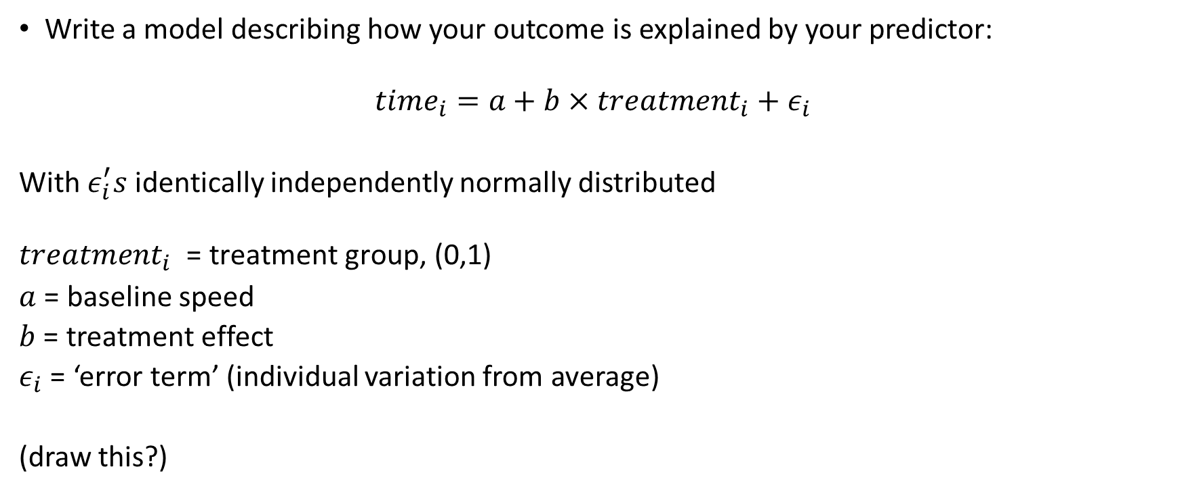
Statistical modelling
Write a model describing how your outcome is explained by your predictor:
$$time_{i}=a+b×treatment_{i}+ε_{i}$$
With $ε_{i}^{′}s$ identically independently normally distributed
$$treatment_{i}\text{ = }\text{treatment} \text{group}\text{, (0,1)}$$
$a$ = baseline speed
$b$ = treatment effect
$ε_{i}$ = ‘error term’ (individual variation from average)
(draw this?)

Slide 9
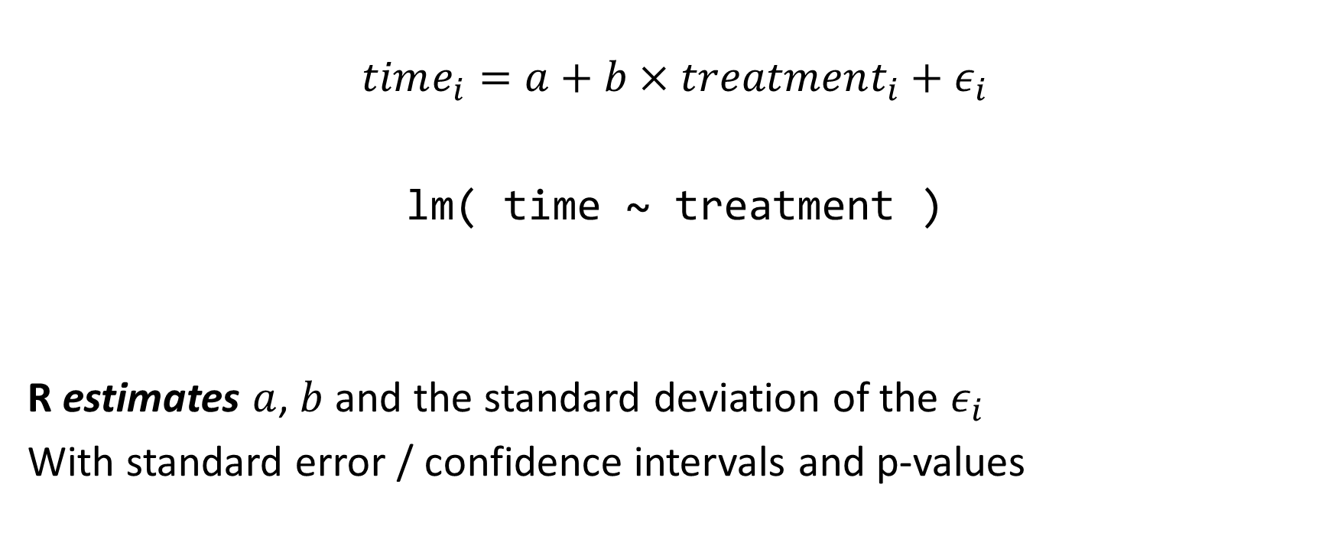
Statistical modelling in R
$$time_{i}=a+b×treatment_{i}+ε_{i}$$
lm( time ~ treatment )
R estimates $a$, $b$ and the standard deviation of the $ε_{i}$
With standard error / confidence intervals and p-values

Slide 10
Extending and understanding the linear model
Very rarely are our experiments this simple
Ad-hoc statistical tests are difficult to extend
With a modelling framework, if we write down how our outcomes are linked to our predictors then we can estimate anything!
lm( time ~ treatment + age + sex + department)
lm( log(time) ~ treatment * sex + age + department )
What kinds of variables are age, sex, department?

Slide 11
Common statistical tests as linear models
Correlation between x and y:
lm( height ~ dgl )
Comparison between two groups (height by health):
lm(height ~ health )
One way ANOVA
lm( height ~ species )
So most analysis workflows:
Get the data into the correct shape
Describe / visualise
Estimate the model
Check that the model fit is OK.
Interpret the coefficients

Slide 12
Extensions of simple lm’s
Multivariable models (equiv. of 2-way ANOVA)
lm( height ~ health + tree.species )
Repeated measures models (with package lme4):
lmer( height ~ health + (1|TreeID) )
Comparing proportions (binary data) with generalised linear models.
glm( health ~ Tree.species , family=“binomial”)

Slide 13
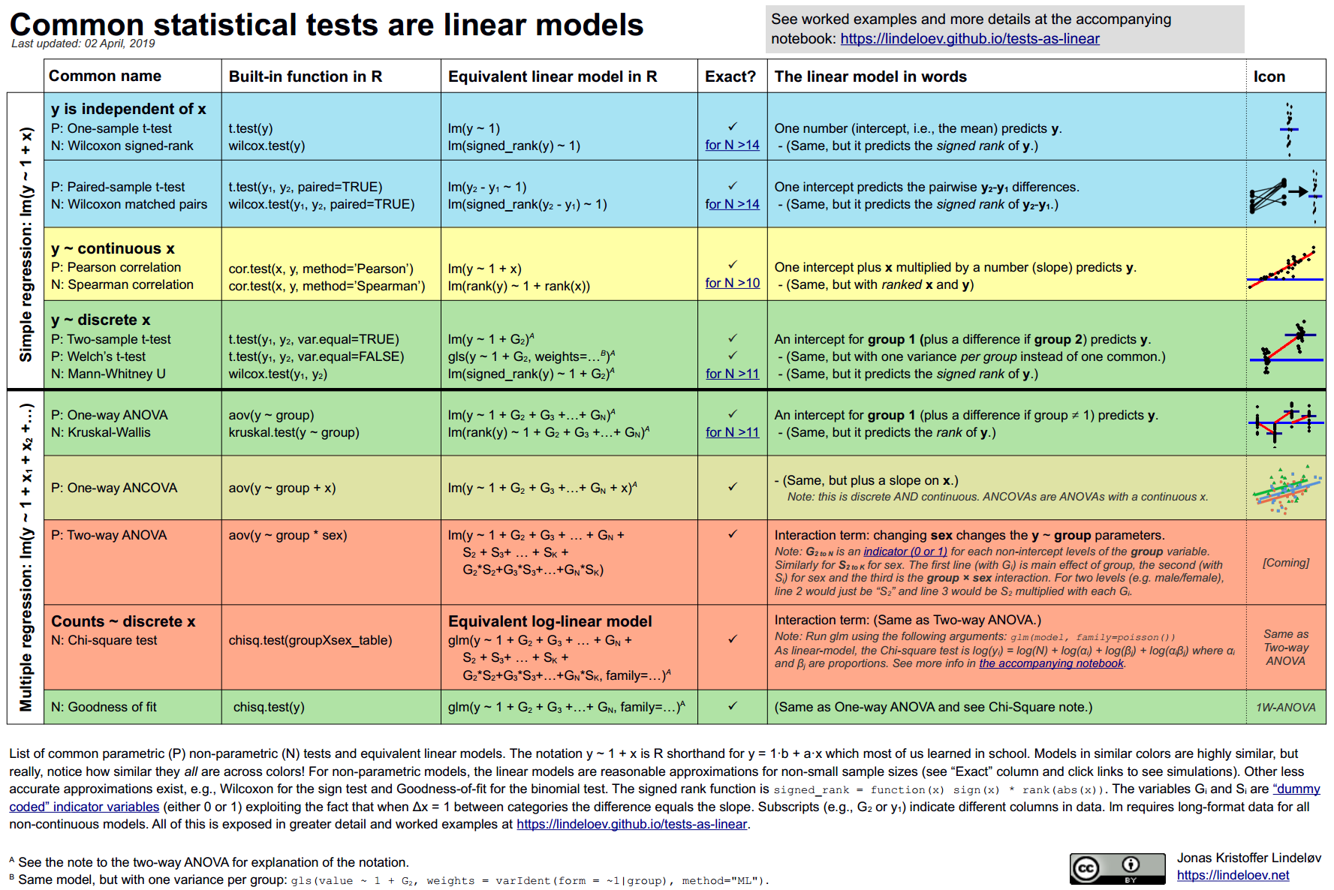
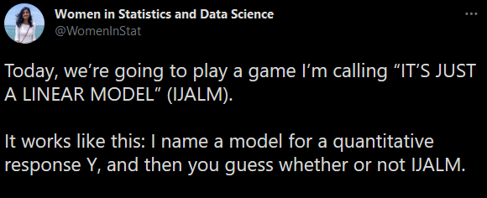
Everything is a linear model
https://lindeloev.github.io/tests-as-linear/
Almost every analysis can be represented like:
Pain ~ Sex + Time
Y ~ X1 + X2 + …
Or some extension of it. So we only need to learn this one paradigm!
https://twitter.com/WomenInStat/status/1286420597505892352

Slide 14
Model diagnostics
The statistical model also makes the model assumptions explicit
Last time I showed you plot() for model diagnostics.
Of course there is a better package I didn’t know about!
performance::check_model()

Slide 15
What do we need to report?
Answer to our question:
Does the treatment work?
What is the treatment effect?
How might we answer:
Does walking speed vary by department?
Does the treatment effect vary by sex?

Slide 16
Statistical modelling and plotting
Data wrangling
(cleaning, coding, reshaping)
Visualisation
Modelling
Reporting
Where does plotting fit into this workflow, and what is it for at each stage?

Slide 17
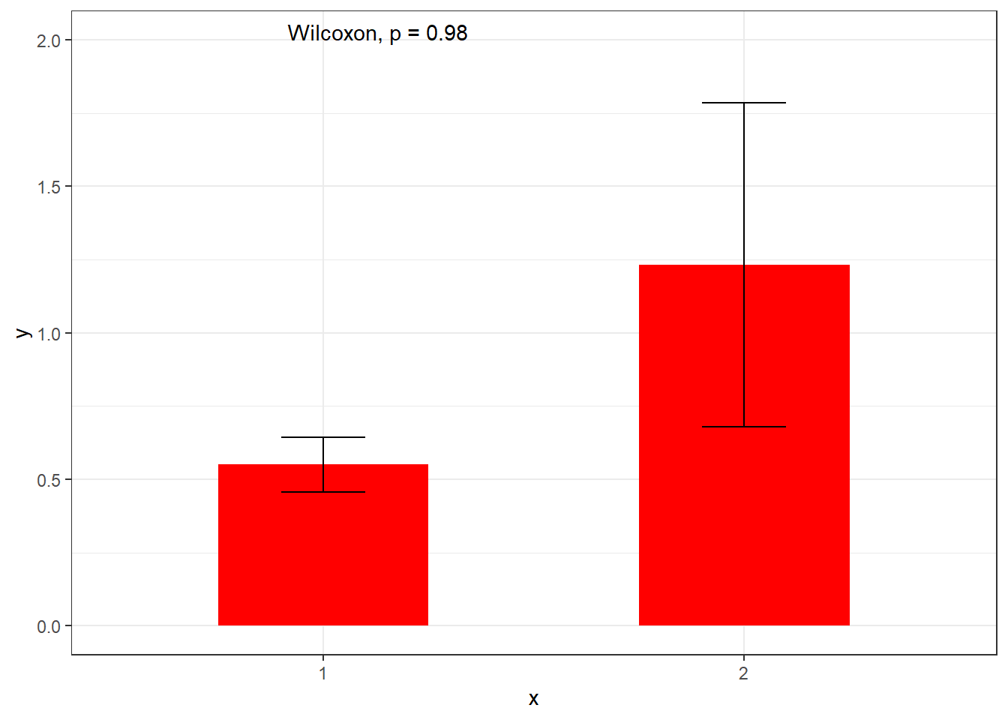
The plot is not the inference
A typical graph..
What is it trying to do?
Visualisation?
Modelling?
Reporting?
How is it helpful / unhelpful?
What might we do differently?
(Go to notes)

Slide 18
ggplot2

Slide 19

ggplot2 vs R ‘base’ graphics
Base graphics
Simple to use
Complicated to adjust
Difficult to get right
ggplot2 (since 2005)
By Hadley Wickham
Slightly more complicated to set up
Very powerful!
Now at version 3
Suggestions: Learn ggplot2!
Be aware of the ‘base’ plotting options plot() etc.
Seek out the many ggplot2 extensions relevant to your field

Slide 20
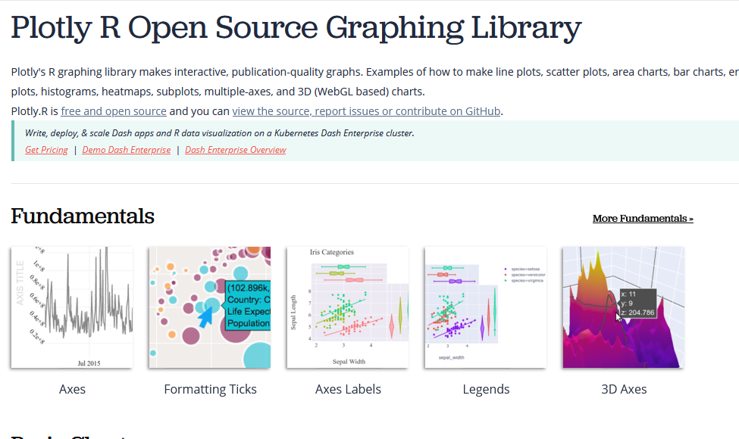
Other R packages for graphics
Plotly (Interactive graphics for the web). www.plotly.com/r/

Slide 21
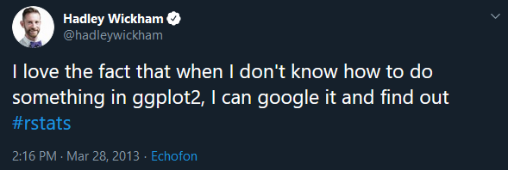
How to learn ggplot2
Thomas Lin Pederson’s videos “Plotting anything with ggplot2” https://www.youtube.com/watch?v=h29g21z0a68
https://www.r-graph-gallery.com/
https://ggplot2-book.org/
https://www.cedricscherer.com/2019/08/05/a-ggplot2-tutorial-for-beautiful-plotting-in-r/
https://github.com/rstudio/cheatsheets/blob/master/data-visualization-2.1.pdf
#30DayChartChallenge (data viz)
#tidytuesday, #Rtistry (generative art with R)
Learn how ggplot2 works.
If you’re stuck, look at a book, official documentation or a vignette
Think about why it does what it does

Slide 22
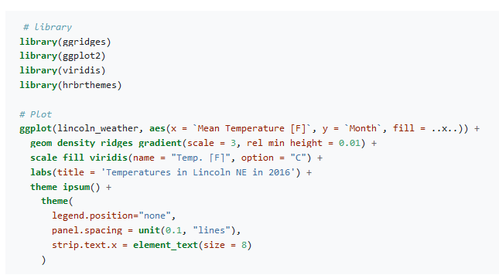
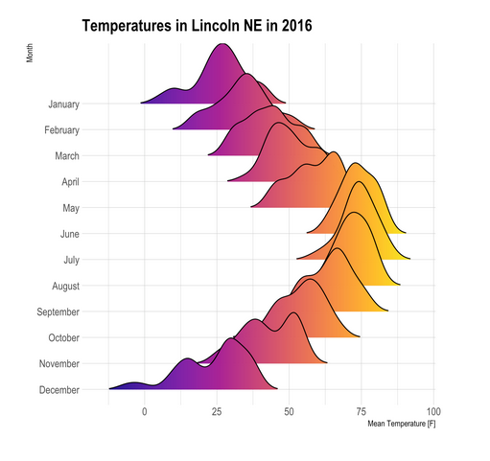
www.r-graph-gallery.com
https://www.r-graph-gallery.com/294-basic-ridgeline-plot.html#color

Slide 23
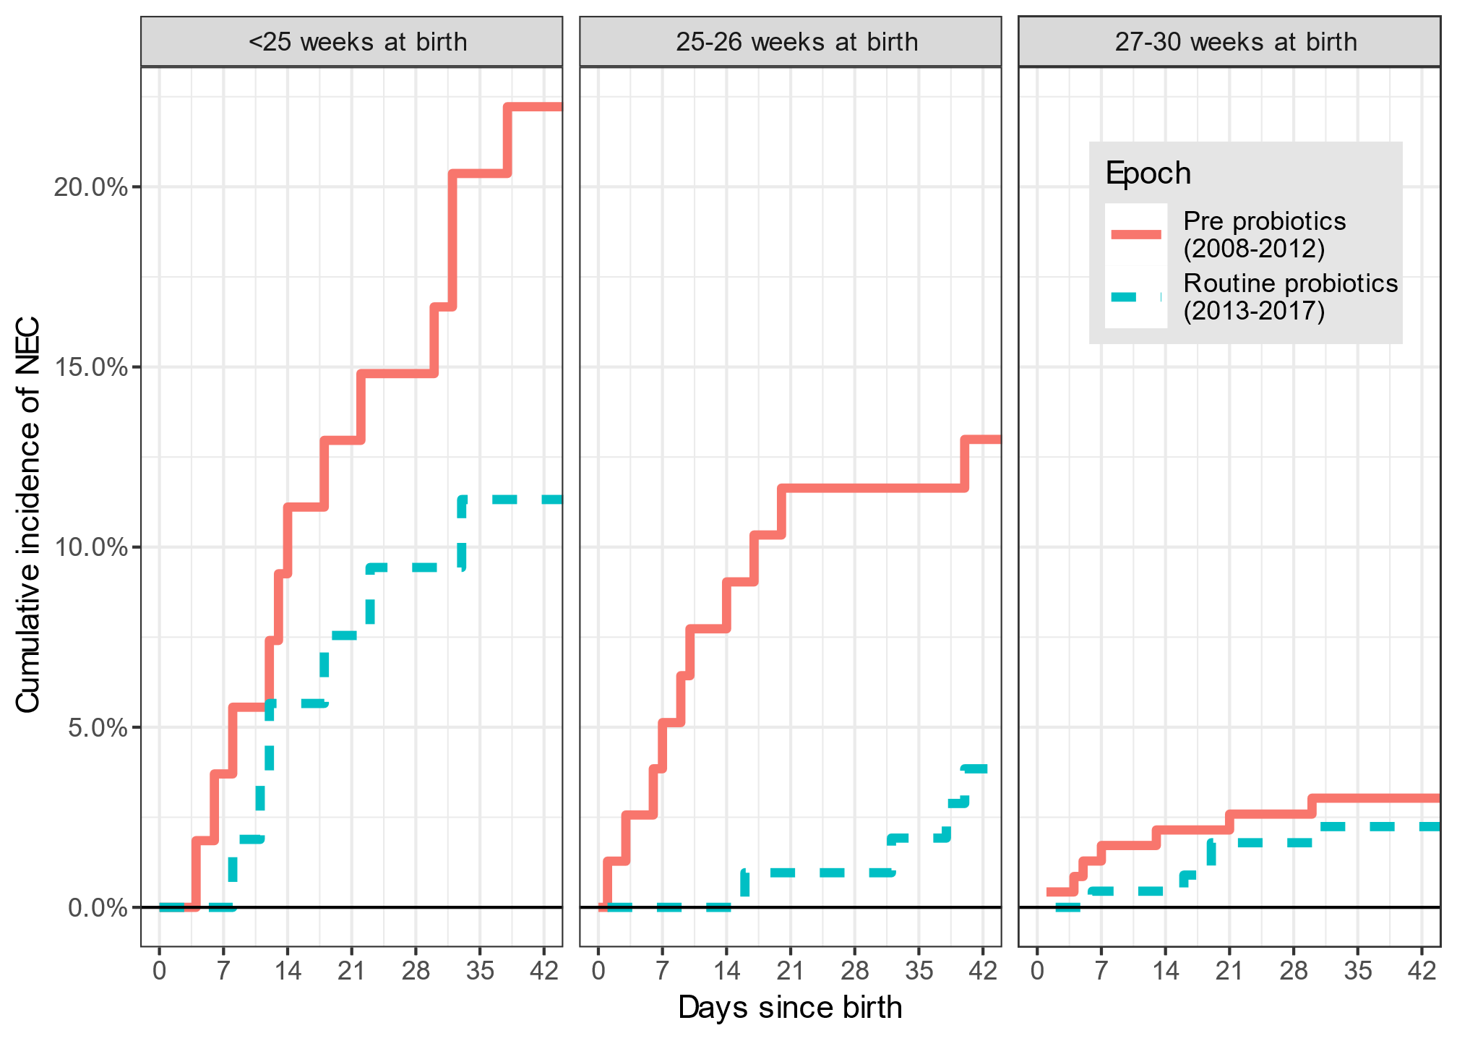
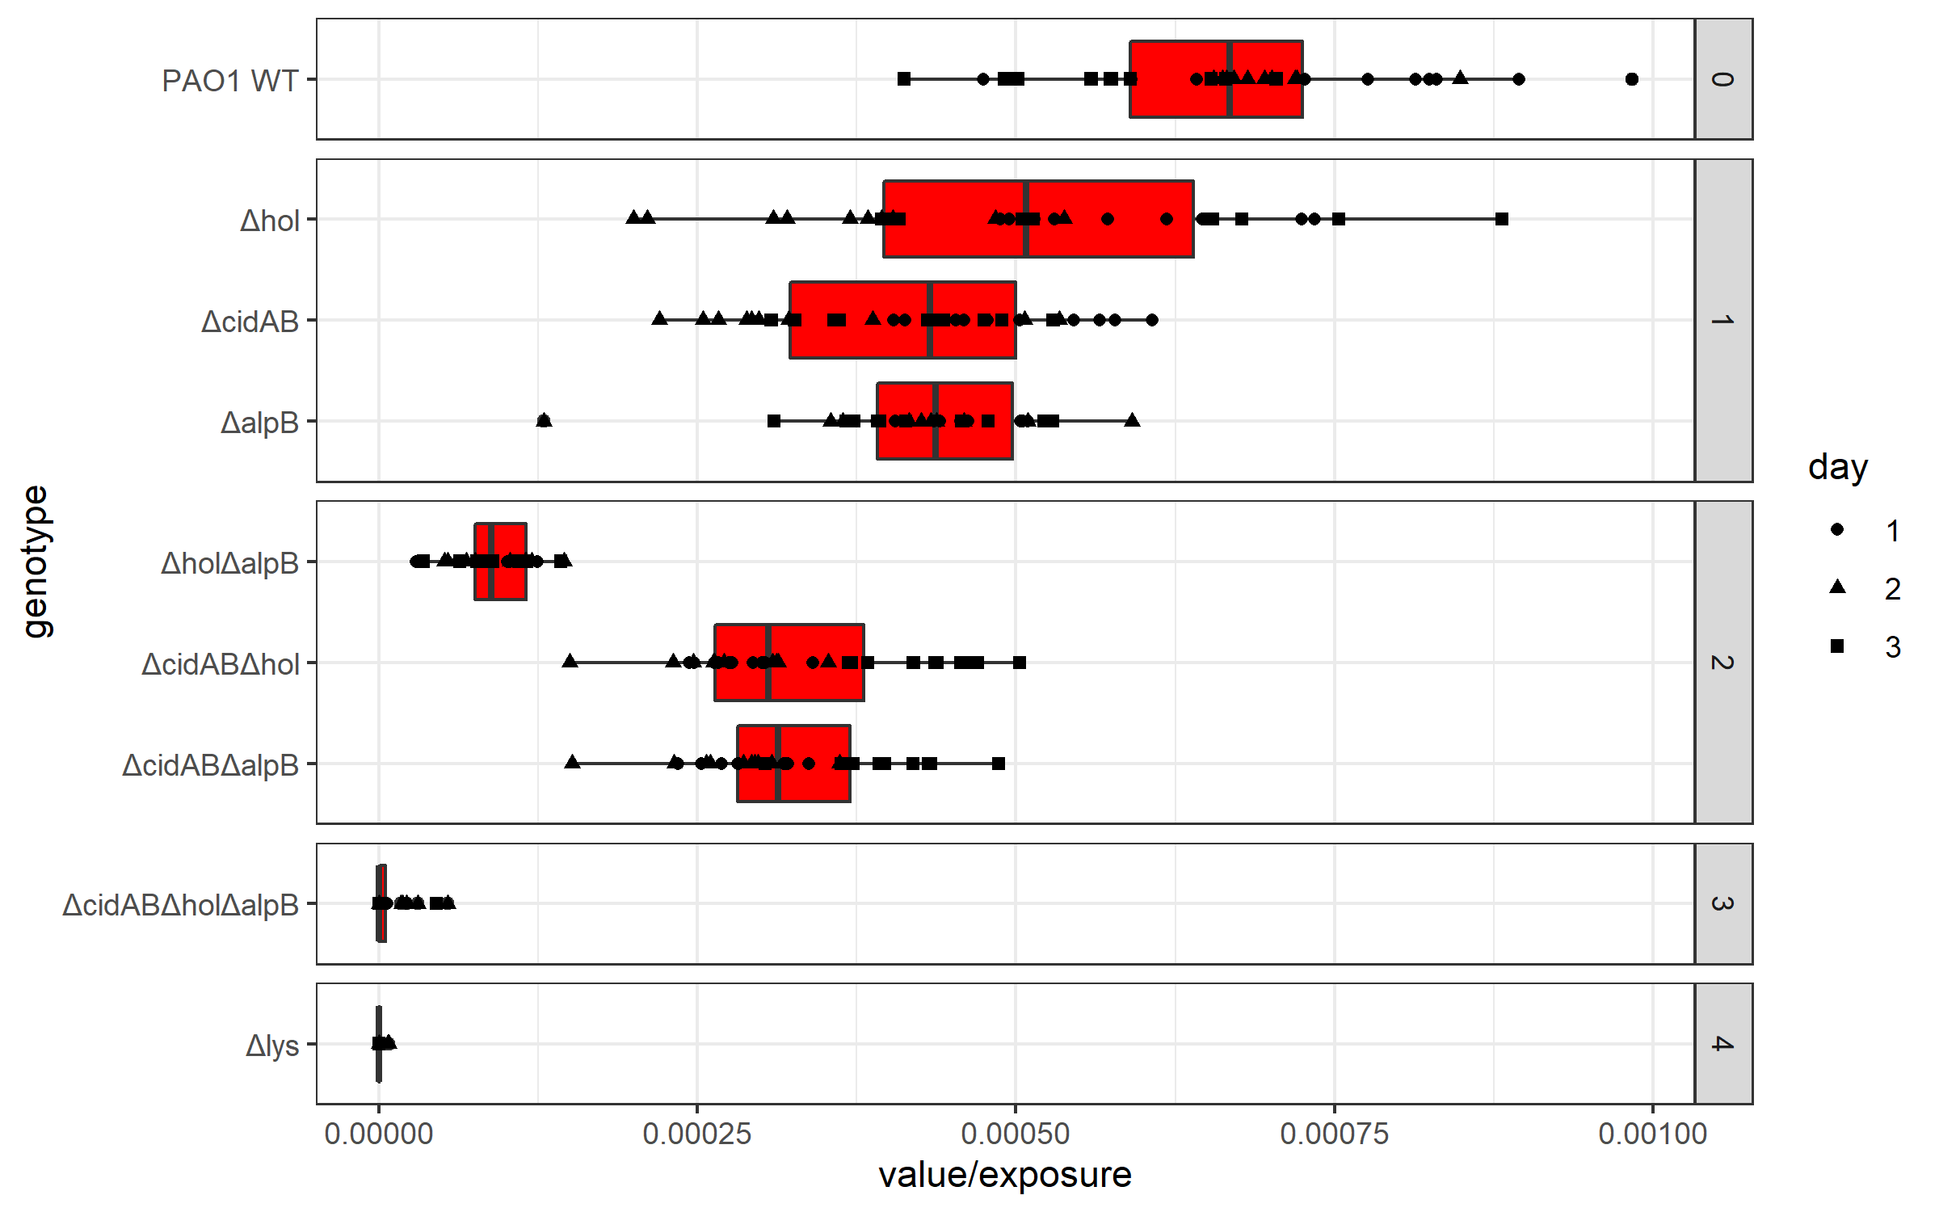
Some graphs I’ve made
Horizontal plots can be easier to read than vertical ones
Can use Unicode characters (here Greek)
Layering two kinds of plot
Facetting
Easy faceting and good control of legends
A cumulative incidence function from ‘survival’ package. *any* set of results can be graphed if we can make it into a dataframe

Slide 24
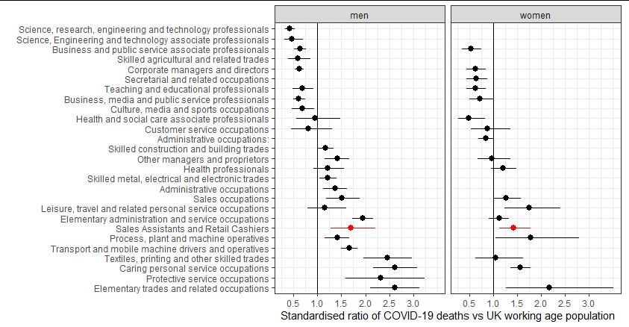
Dot plots / Confidence intervals

Slide 25
Some graphs I’ve made
Using ‘ggrepel’ labels will avoid points and each other

Slide 26
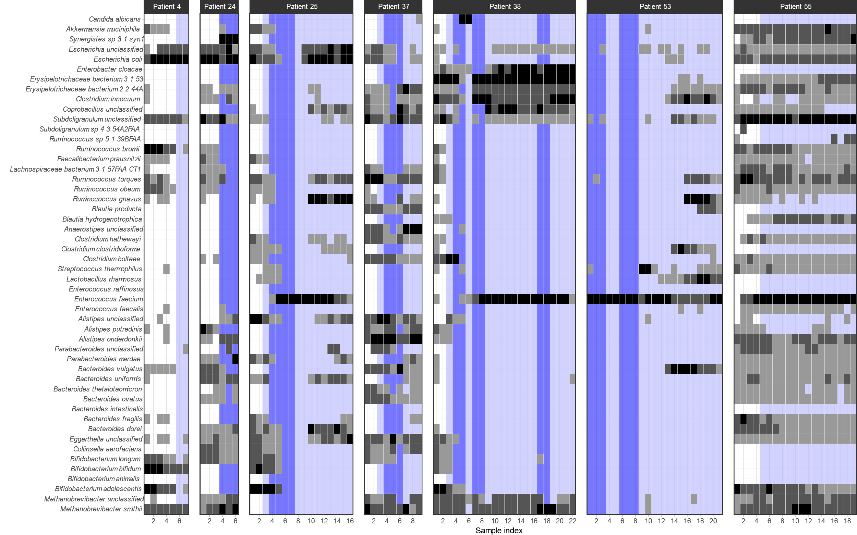
heatmaps

Slide 27
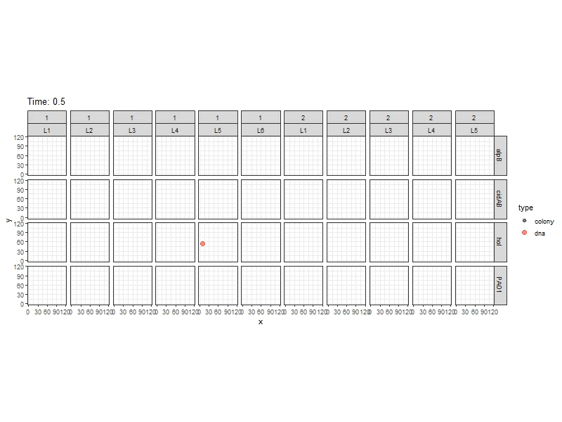
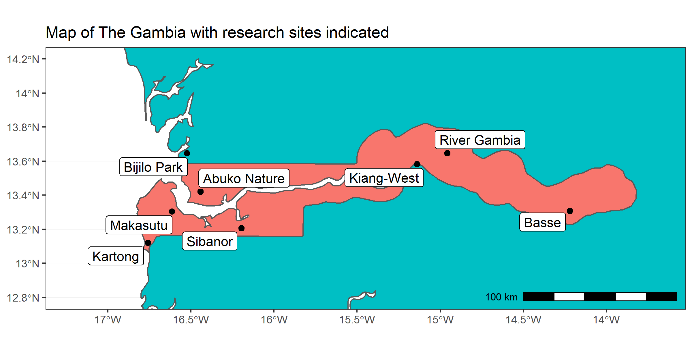
Packages for extending ggplot:
sf (maps)
gganimate (animation)
There are hundreds of these add on packages!

Slide 28
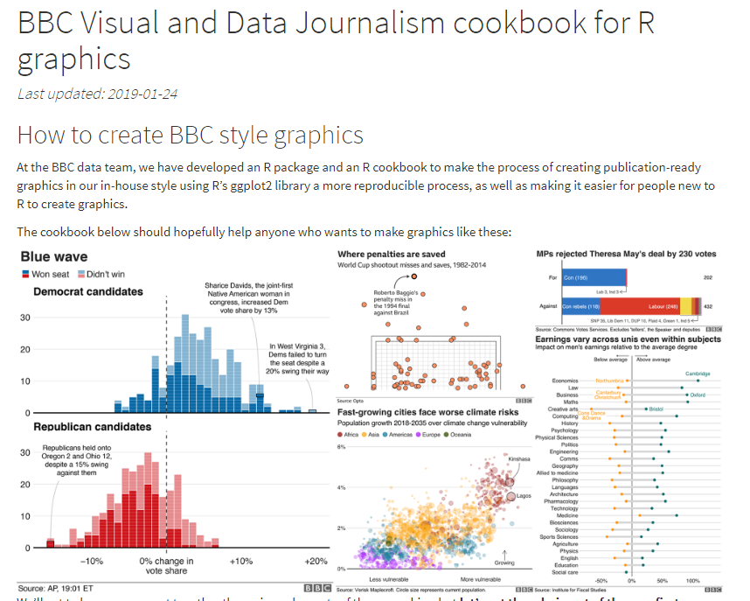
https://bbc.github.io/rcookbook/
The BBC and FT now only use R and ggplot2 to make their graphics

Slide 29
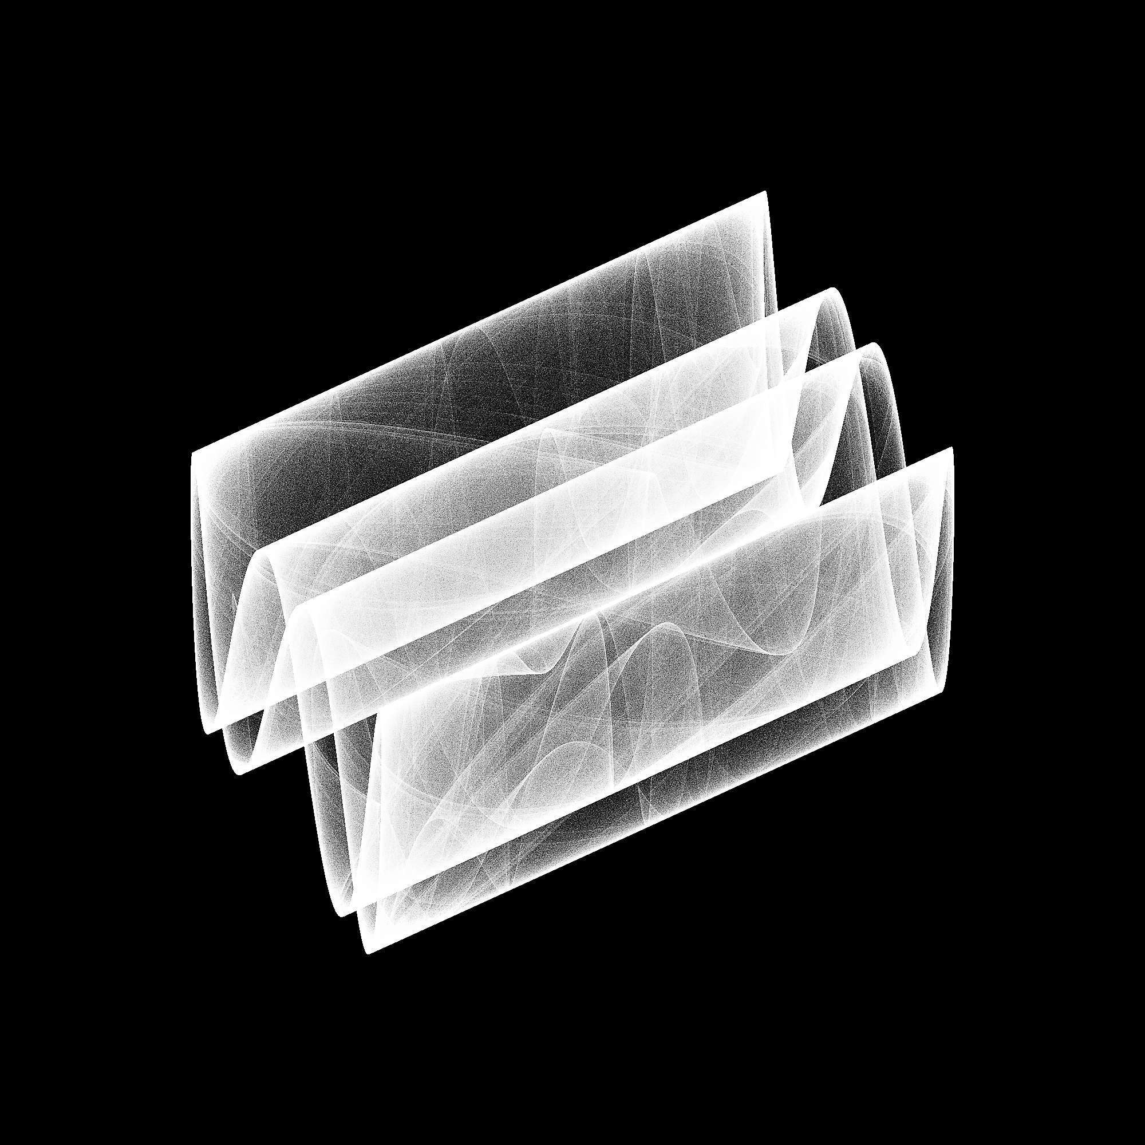
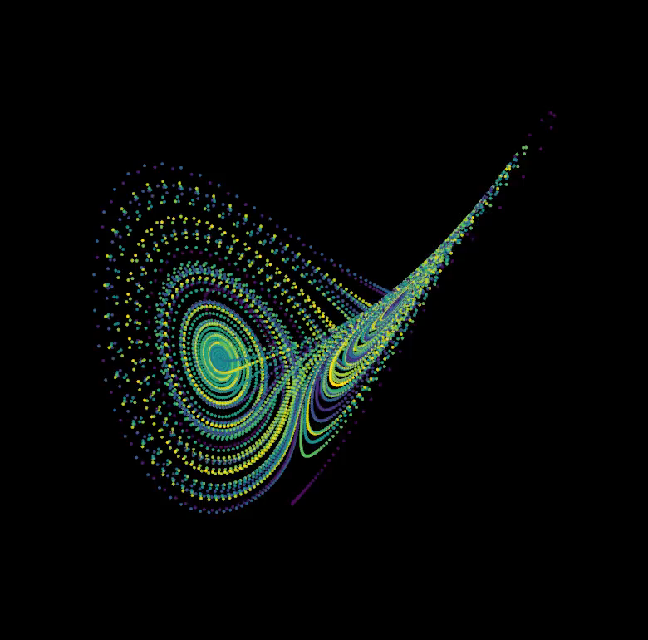
Plotting for fun!

Slide 30
The only limit is your imagination
Data coaster! https://www.tylermw.com/datacoaster-tycoon/

Slide 31
A simple example (do this)
ggplot( data = walkingdata ) +
aes(x=age, y=time) +
geom_point()

Slide 32
Common grammar of graphics
How does ggplot2 work?
You describe the components of the graph you want in code
Using a ‘grammar of graphics’ that describes how your data should be presented.
ggplot2 implements this idea for R
(go to flipbook).

Slide 33
Aesthetic mapping
The central idea of ggplot is aesthetic mapping
Aesthetic mapping
Aesthetics
Data
sex
x
age
y
patid
color
treated
size
time
shape

Slide 34
Elements of ggplot2 grammar
Data – which data frame to use
Aesthetic mapping – how the variables in your data map onto the graph and graph objects
Geometric objects – what objects represent the data (box, line, point etc)
Scales – how should values be mapped and labelled
Facets – stratification of the graph
Statistics – eg means, counts or standard errors
Coordinates –the dimensions of the plot
Labels – how should the aesthetics be labelled
Theme – extra detail about the look

Slide 35
Step 1 - data
Choose the data frame that you want to use:
ggplot(alldata)
This won’t do anything useful by itself

Slide 36
Step 2 – aesthetic mapping
Aesthetic mapping:
How are the columns in your data represented on your graph
First decide which variables will be represented on the x and y axes:
ggplot(alldata, aes(x=treated, y=time))
What did it do?

Slide 37
Step 3 – add a ‘geom’
Add a geometric object:
ggplot(walkingdata, aes(x=treated, y=time)) + geom_point()
Note the ‘+’ used to ‘add’ gg objects. This is how we add elements together.

Slide 38
Aesthetic mapping
ggplot(walkingdata, aes(x=treated, y=time)) + geom_point()
Data
Aesthetics used by geom_point
sex
x
age
y
patid
color
treated
size
time
Aesthetic mapping
shape
ggplot(walkingdata) + geom_point(aes(x=treated, y=time))
ggplot(walkingdata) + aes(x=treated, y=time) + geom_point()

Slide 39
geoms that I use a lot
Geometric object | Use
geom_point | Points (scatter plot)
geom_line | Lines
geom_boxplot | Box plots
geom_errorbar / geom_pointrange | Error bars
geom_bar / geom_histogram / geom_col | Histograms or bar graphs
geom_tile / geom_raster | Heatmaps
geom_text / geom_label | Text labels within the graph area
geom_beeswarm | ‘beeswarm’ graphs
geom_label_repel / geom_text_repel | Text and labels that ‘get out of the way’

Slide 40
Which aesthetics do they need or use?
Geometric object | Possible aesthetics. Needed = bold.
geom_point | x, y, alpha, color, fill, group, shape, size, stroke
geom_line / geom_path / geom_step | x, y, alpha, color, linetype, size, group
geom_boxplot | x, (y), (lower, upper, middle, ymin, ymax), alpha, colour, fill, group, linetype, shape, size, weight
geom_errorbar / geom_pointrange | x, (y), ymin, ymax, size, linetype, colour, width, alpha
geom_histogram / geom_bar | x, y, alpha color, fill, group, linetype, size
geom_tile / geom_raster | x, y, alpha, color, fill, group, height, linetype, size, width
geom_text / geom_label | x, y, label, alpha, colour, fill, group, shape, size, stroke
geom_beeswarm | same as geom_point
geom_label_repel / geom_text_repel | same as geom_text

Slide 41
4 - Scales
Scale functions describe how the values in the data map to the aesthetic
For example:
Setting breaks for axis aesthetics:
scale_x_continuous(breaks=c(1,2,3,4,5))
Changing the scale to logarithmic:
scale_y_log10()
Picking more visually appealing colours for continuous or discrete scales:
scale_color_brewer() # There are hundreds of available colour palettes.
scale_fill_manual(values=c(“red”,”blue”,”green”))

Slide 42
4 – Change the scale
Scales define how the variable is mapped to the geom
ggplot(alldata, aes(x=treated, y=time)) + geom_point() + scale_y_log10()
Scales are also how we define specific colours and shapes:
ggplot(alldata, aes(x=treated, y=time, color=treated)) + geom_point() + scale_y_log10() + scale_color_manual(values=c(“treated”=“red”, “control”=“black”))

Slide 43
5 - Summary statistics
As well as the raw data we can add summaries.
Add (for example) means and standard error.
+ stat_summary( geom=“bar”, fun.y=mean ) +
stat_summary( geom=“errorbar”, fun.data=mean_se )
A scatter plot can take stat_smooth() to add a lowess or regression line.

Slide 44
Adding p-values (try to avoid this)
The ‘ggpubr’ library can add p-values to a plot:
install.packages("ggpubr")
library(ggpubr)
ggplot(alldata2, aes(x=treated, y=speed, fill=treated)) + geom_boxplot() + facet_wrap(~sex) + scale_fill_manual(values=c("red","green")) + stat_compare_means(method="t.test", comparisons = list(c("Control","Treat")))

Slide 45
Exercises
Load the walking speed data from the “fixed” sheet.
Exercise 1
Make a scatter plot of time vs age
Change this plot to make the color of each point reflect the sex of the patient
Change the y-axis to reflect a log-scale
Add a regression line
Exercise 2
Make a suitable plot showing the distribution of time varies by sex, using different colours for each sex
Add the individual points back on top of the boxplot using a points (or beeswarms, for which you’ll need to install the ggbeeswarm package)

Slide 46
5 – Facets
Can can easily stratify plots using variables in your dataset
facet_wrap() is easier to use
facet_grid() gives you more control in two dimensions
ggplot(alldata, aes(x=treated, y=time)) + geom_boxplot() + scale_y_log10() + facet_wrap(~sex)

Slide 47
8. Labels
Next, we’ll fix the labels:
ggplot(alldata2, aes(x=treated, y=speed, fill=treated)) + geom_boxplot() + geom_beeswarm() + facet_wrap(~sex, labeller=labeller(sex=c("Male", "Female")) + scale_fill_manual(values=c("red","green")) + stat_compare_means(method="t.test", comparisons = list(c("Control","Treat"))) + labs(x="Treatment", y="Walking speed (m/s) ", fill="Treatment")
# Notice that to assign variable labels, labs() labels the aesthetics (x, y, fill), not the variables themselves!
Add facets and la

Slide 48
9. Themes…and done!
Control the overall look. I almost always use theme_bw() for publication graphs
Control individual elements with theme()
ggplot(alldata, aes(x=treated, y=time, fill=treated)) +
geom_boxplot() +
geom_beeswarm(cex=3) +
facet_wrap(~sex, labeller=labeller(sex=c(M="Male",F="Female"))) +
scale_fill_manual(values=c("red","green")) +
scale_y_log10() +
stat_compare_means(method="t.test", comparisons = list(c("Control","Treat"))) +
labs(x="Treatment", y="Walking speed (m/s) ", fill="Treatment") +
theme(legend.position = "none") + theme_bw()

Slide 49
Exercises
Add a facet, set the labels and change the overall theme of one of your graphs.
Choose one problem:
Does walking speed vary by department?
Does the treatment effect of our intervention vary with sex?
Does the treatment effect of our intervention vary with age?
Make a suitable plot to explore the data
Estimate a model, and check that it meets the model assumptions

Slide 50
A similar graph with ‘base’ graphics
This is possible but the code is much messier.
par(mfrow=c(1,2))
boxplot(data=subset(alldata2, sex=="M"), speed ~ treated, col=c("red","green"), main="Male")
beeswarm(speed ~ treated, data = subset(alldata2, sex=="M"), add = TRUE, col = 'black', pch=20)
boxplot(data=subset(alldata2, sex=="F"), speed ~ treated, col=c("red","green"), main="Female")
beeswarm(speed ~ treated, data = subset(alldata2, sex=="F"), add = TRUE, col = 'black', pch=20)

Slide 51
Saving ggplot2 graphs
Options for including ggplot2 graphics in documents:
Incorporate in Rmarkdown document
Manually export from RStudio
ggsave() function
You can choose the size, scale, image format and resolution.
Use vector graphics (svg) or high resolution ratser (png with dpi=“retina”).
Getting the size/scale right can be trial and error.

Slide 52
Thank you
This has been a very brief overview
Basics of R and Rstudio
Loading data from Excel
Tidy data
Simple tests
Linear models
Graphing
Signposting to resources
I hope you finish the handouts
Remember – contact me if needed and continue to read and learn
Support each other
Please complete feedback forms or let me know what you think directly

